Slide 1

Basic Details of the Team and Problem Statement
Mobile Computing With Android
Project Synopsis & Report
Project Title: Tic Tac Toe
Application Domain: Games/Entertainment
Created by: Vishwa Shah

Slide 2
Idea Approach Details
Technologies used :
1. Java :
Used as the primary programming language to handle game logic, user interactions, and activity lifecycle in Android. Java is well-supported in Android development and perfect for beginners building mobile apps.
2. Android SDK (Framework):
Provides the core tools and libraries needed to build Android apps. It supports activity management, UI elements, and system interactions.
3. XML (User Interface Design):
Used to define the layout and visual structure of the app — including buttons, grid layout, text views, and overall app styling.
4. Android Studio (IDE):
The main development environment used to write, compile, test, and debug the app. It offers an emulator for testing and tools for layout preview, resource management, and performance checks.
About Application:
This is a simple yet fully functional Tic Tac Toe mobile app built for Android. The game allows two players to play turn-by-turn on a 3x3 grid and includes all core features like win detection, draw checking, and a game reset button. It’s a great beginner-friendly project that covers the fundamentals of Android development — UI design, event handling, game logic, and state management.

Slide 3
Idea Approach Details
Flowchart:
App starts and loads layout
Player taps a cell
If cell is empty → mark X or O
Check for win or draw
If game ends → show result & lock board
Else → switch turn
Press reset to play again
Use cases:
Play with a Friend – Two-player mode on the same device
Casual Mobile Game – Quick fun during free time
Learn Android Dev – Great for practicing Java + UI handling
Logic & Problem Solving – Builds game logic and thinking
Expandable – Base for future upgrades (AI, themes, multiplayer)

Slide 4
XML CODE:
<?xml version="1.0" encoding="utf-8"?><LinearLayout xmlns:android="http://schemas.android.com/apk/res/android" android:orientation="vertical" android:padding="16dp" android:layout_width="match_parent" android:layout_height="match_parent" android:gravity="center" android:background="#FFFDF7"> <TextView android:id="@+id/textViewStatus" android:layout_width="wrap_content" android:layout_height="wrap_content" android:text="Tic Tac Toe" android:textSize="24sp" android:textStyle="bold" android:layout_marginBottom="20dp" /> <GridLayout android:layout_width="wrap_content" android:layout_height="wrap_content" android:columnCount="3" android:rowCount="3" android:layout_marginBottom="24dp"> <!-- 3x3 Grid Buttons --> <Button android:id="@+id/button_00" style="@style/TicTacToeButton"/> <Button android:id="@+id/button_01" style="@style/TicTacToeButton"/> <Button android:id="@+id/button_02" style="@style/TicTacToeButton"/> <Button android:id="@+id/button_10" style="@style/TicTacToeButton"/> <Button android:id="@+id/button_11" style="@style/TicTacToeButton"/> <Button android:id="@+id/button_12" style="@style/TicTacToeButton"/> <Button android:id="@+id/button_20" style="@style/TicTacToeButton"/> <Button android:id="@+id/button_21" style="@style/TicTacToeButton"/> <Button android:id="@+id/button_22" style="@style/TicTacToeButton"/> </GridLayout> <Button android:id="@+id/buttonReset" android:layout_width="wrap_content" android:layout_height="wrap_content" android:text="Reset" android:padding="12dp" android:backgroundTint="#FF9800" android:textColor="#FFFFFF" android:textStyle="bold" /></LinearLayout>

Slide 5
Java code:
package com.example.tictactoe;
import android.os.Bundle;
import android.view.View;
import android.widget.Button;
import android.widget.TextView;
import androidx.appcompat.app.AppCompatActivity;
public class MainActivity extends AppCompatActivity implements View.OnClickListener {
private Button[][] buttons = new Button[3][3];
private boolean playerXTurn = true;
private int roundCount;
private TextView textViewStatus;
private Button resetButton;
@Override protected void onCreate(Bundle savedInstanceState) { super.onCreate(savedInstanceState);

Slide 6
setContentView(R.layout.activity_main);
textViewStatus = findViewById(R.id.textViewStatus);
resetButton = findViewById(R.id.buttonReset);
for (int i = 0; i < 3; i++) { for (int j = 0; j < 3; j++) { String buttonID = "button_" + i + j;
int resID = getResources().getIdentifier(buttonID, "id", getPackageName());
buttons[i][j] = findViewById(resID);
buttons[i][j].setOnClickListener(this); } }
resetButton.setOnClickListener(new View.OnClickListener() {
@Override public void onClick(View v) {
resetGame(); } }); }
@Override public void onClick(View v) {
Button clicked = (Button) v;
if (!clicked.getText().toString().equals("")) {
return; }
clicked.setText(playerXTurn ? "X" : "O");
roundCount++; if (checkForWin()) {
textViewStatus.setText((playerXTurn ? "X" : "O") + " wins!");
disableButtons(); }
else if (roundCount == 9) {
textViewStatus.setText("Draw!"); } else {
playerXTurn = !playerXTurn; } }
private boolean checkForWin() { String[][] field = new String[3][3];
for (int i = 0; i < 3; i++) {
for (int j = 0; j < 3; j++) {

Slide 7
field[i][j] = buttons[i][j].getText().toString(); } }
for (int i = 0; i < 3; i++) {
if (field[i][0].equals(field[i][1]) &&
field[i][0].equals(field[i][2]) && !field[i][0].equals("")) {
return true; } }
for (int i = 0; i < 3; i++) {
if (field[0][i].equals(field[1][i]) &&
field[0][i].equals(field[2][i]) && !field[0][i].equals("")) {
return true; } }
if (field[0][0].equals(field[1][1]) && field[0][0].equals(field[2][2]) && !field[0][0].equals("")) { return true; }
if (field[0][2].equals(field[1][1]) && field[0][2].equals(field[2][0]) && !field[0][2].equals("")) { return true; }
return false; }
private void disableButtons() {
for (int i = 0; i < 3; i++) {
for (int j = 0; j < 3; j++) {
buttons[i][j].setEnabled(false); } } }
private void resetGame() {
for (int i = 0; i < 3; i++) {
for (int j = 0; j < 3; j++) {
buttons[i][j].setText("");
buttons[i][j].setEnabled(true); } }
roundCount = 0;
playerXTurn = true;
textViewStatus.setText("Tic Tac Toe"); }}

Slide 8
Style
<style name="TicTacToeButton">
<item name="android:layout_width">80dp</item>
<item name="android:layout_height">80dp</item>
<item name="android:textSize">24sp</item>
<item name="android:textStyle">bold</item>
<item name="android:backgroundTint">#E0E0E0</item>
<item name="android:textColor">#000000</item>
<item name="android:layout_margin">4dp</item>
</style>

Slide 9
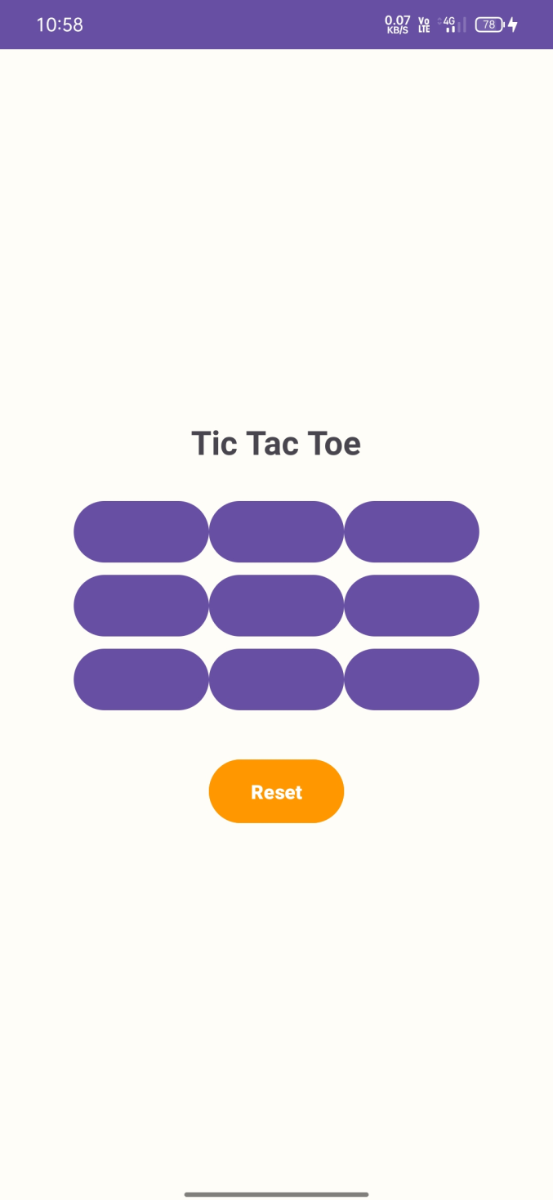

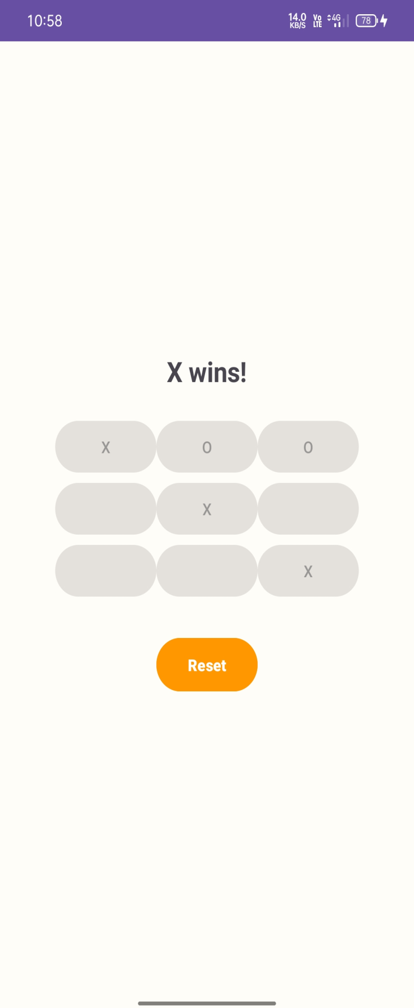

Slide 10
Conclusion & Future Plans
Key Takeaways
Built a basic Android app using Java
Learned UI design with XML
Implemented game logic and win checks
Future Enhancements
Add AI for single-player mode
Track scores across games
Add themes, sounds & animations
Enable online or Bluetooth multiplayer

